Slide 1

TURBIDITY SENSOR MLA0104-AIES
GUIDED BY: DR.PRAKASH MATHIALAGAN
PRESENTED BY:
P SURENDRA KUMAR REDDY(192425224)

Slide 2


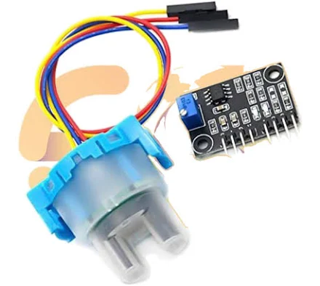
INTRODUCTION
Turbidity means the cloudiness of water.
It is caused by dirt, mud, algae, and other suspended particles.
Clear water has low turbidity.
Cloudy or dirty water has high turbidity.
A turbidity sensor measures the cloudiness of water.

Slide 3
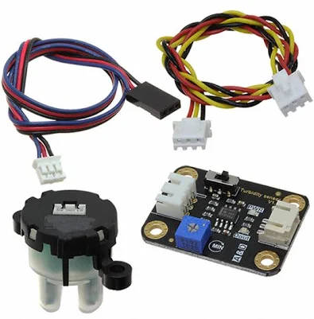
TURBIDITY SENSOR: IMAGE & COMPONENTS
Light Source
Sends light through the water sample.
Water Sample
Contains suspended particles that affect the light.
Photodetector
Detects the transmitted or scattered light.
Signal Processing Circuit
Converts the detected light into an electrical signal.
Analog OUT
Provides a continuous signal based on the turbidity level.
Digital OUT
Provides a HIGH/LOW signal when turbidity crosses a preset level.

Slide 4
HOW THE COMPONENTS WORK
Water → Light Source → Particles → Photodetector → Output
Light is sent through the water sample.
Suspended particles scatter the light.
The photodetector detects the change in light intensity.
The sensor converts this change into an electrical signal.
The output indicates the turbidity level of the water.

Slide 5


APPLICATIONS
Where is it Used?
Drinking Water Monitoring – Checks the clarity and quality of drinking water.
Water Treatment Plants – Monitors turbidity during the water purification process.
Rivers and Lakes – Detects changes in the quality of natural water sources.
Aquaculture – Helps maintain suitable water conditions for fish and aquatic life.
Industrial Wastewater – Monitors suspended particles in wastewater before discharge.
Environmental Monitoring – Supports continuous monitoring of water quality.

